Slide 1
ALGORITHMS FOR BIG DATA PROJECT
Topic: “Estimating the intrinsic dimension of datasets by a minimal neighborhood information”

Slide 2
Plan
Definition of Intrinsic Dimension (ID)
Importance of ID
History about ID algorithm
Presentation of our algorithm
Runtime and storage analysis of our algorithm: 2NN ID estimation
Evaluation of our algorithm with known ID dataset
Some example

Slide 3
WHAT IS THE INTRINSIC DIMENSION AND WHY IS IT IMPORTANT
?

Slide 4
HIGH DIMENSIONAL DATASETS AND THEIR PROBLEMS

Slide 5

BIOINFORMATICS

Slide 6
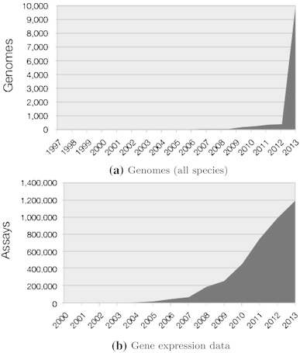
Immage refference: (PDF) Big Data Analytics in Bioinformatics: Architectures, Techniques, Tools and Issues (researchgate.net)
NUMBER OF DATA INCREASE ALONG THE YEARS

Slide 7
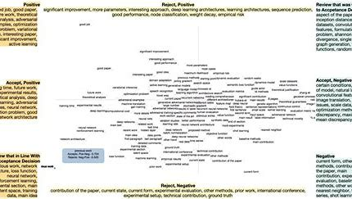
TEXT MINING
Image source: [P] How to write a persuasive ICLR review: text mining the OpenReview dataset : MachineLearning (reddit.com)

Slide 8
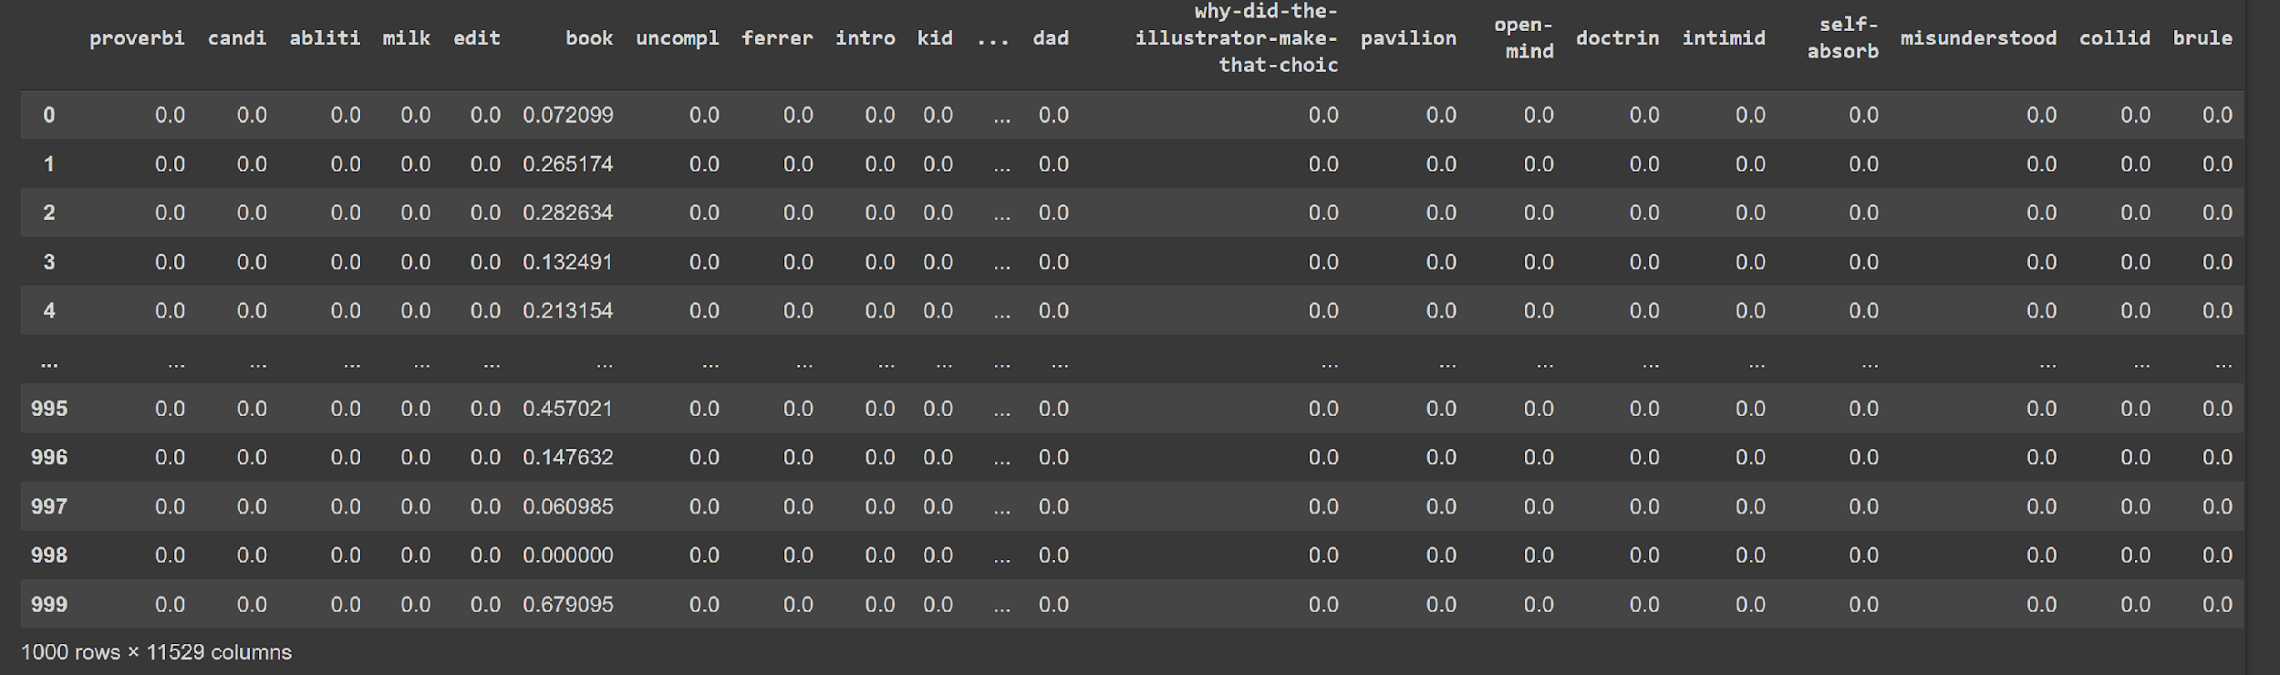
TEXT MINING DATASET

Slide 9
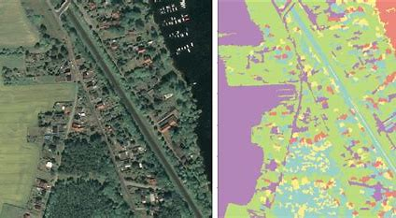
IMAGE ANALYSIS AND PROCESSING
Image source: Satellite Image Processing Made Simple · UP42

Slide 10
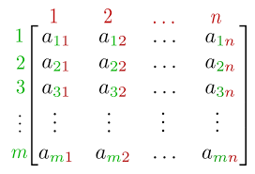
WHAT DOES IT HAPPEN IF «n» IS LARGER THAN «m» ?

Slide 11

1) COMPUTATIONAL COST
SCALE-IN / SCALE-OUT

Slide 12
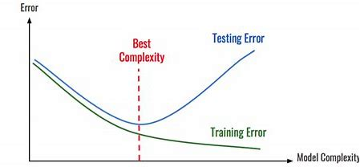
2) HIGH RISK OF OVERFITTING
IMAGE SOURCE: Overfitting, bias-variance and learning curves - rmartinshort (jimdofree.com)

Slide 13
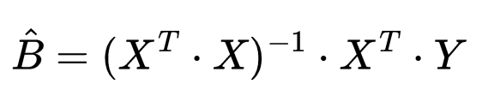

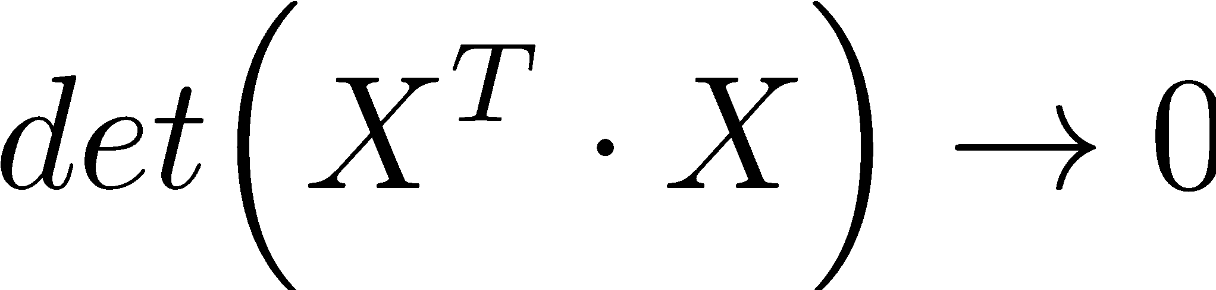
3) LEAST SQUARE LINEAR REGRESSION FORMULA
Increasing the number of dimensions

Slide 14
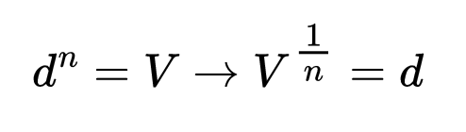
4) COURSE OF DIMENSIONALITY
Consider a point X_{q} in an n dimensional space
Consider a hypercube of edge d < 1 and thus volume V < 1

Slide 15

Define K as the number of neighbors of X_{q} inside in the hypercube. For a fixed N (number of points in the space) and V < 1:
As n → ∞ then K → 0:

Slide 16
INTRINSIC DIMENSION (ID)

Slide 17
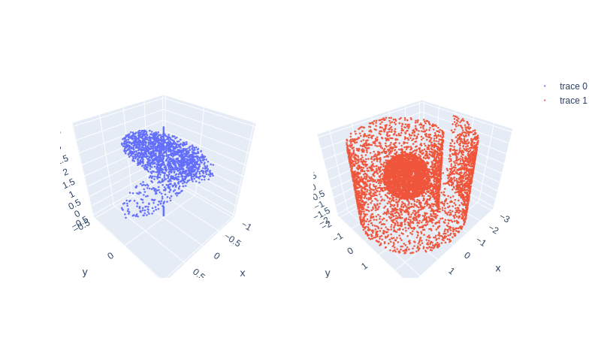
HISTORY OF ID ESTIMATION
Manifolds: a generalization and abstraction of the notion of a curved surface (from Britannica)
Notion of fractal
the minimal and accurate representation of dataset.
Generally 2 types of methods:
the projection method type:
Project the data into a new space with a lower dimension
eigenvalue methods
Example: PCA,
the geometric method type:
it is based on the nearest neighbor (NN) distance or fractal dimensions
Example: NN, MLE

Slide 18
History of ID Estimation
- some Algorithms
Johnson Lidenstrauss projection method
Gaussian Random projection
MLE algorithm
PCA algorithm

Slide 19
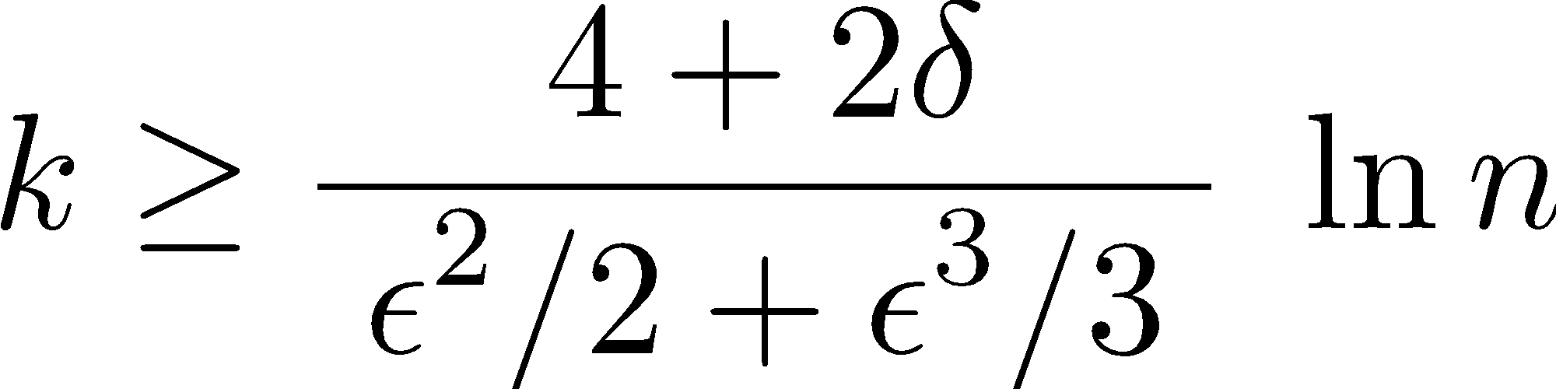

History of ID Estimation - some algorithms: Johnson Lidenstrauss
low-distortion embeddings of points from high-dimensional into low-dimensional Euclidean space
Dimension k
failure probability of δ

Slide 20

History of ID Estimation - some Algorithms: Gaussian Random projection
Matrix dimension as parameter
Gaussian random method projects the original input space on a randomly generated matrix to reduce dimensions
No relationship with the dataset different values
The distribution

Slide 21
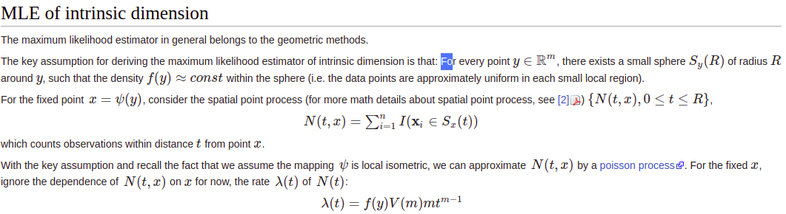
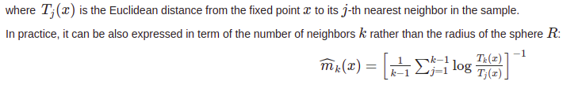
History of ID Estimation - some Algorithms: MLE
Maximum Likelihood Estimator
ID: m
Book link:
https://papers.nips.cc/paper/2004/file/74934548253bcab8490ebd74afed7031-Paper.pdf
Source: wiki.math.uwaterloo.ca

Slide 22
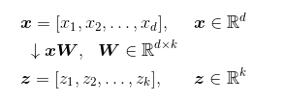
History of ID Estimation - some Algorithms: PCA
Use of eigenvalues
The intrinsic dimension is determined by the number of eigenvalues that are greater than a given threshold.
PCA can be used to estimate the dimensionality of a globally linear subspace
PCA aims to find the directions of maximum variance in high-dimensional data and projects them onto a new subspace with equal or fewer dimensions than the original one.

Slide 23
PROPOSED APPROACH: TWO-NN ID ESTIMATOR

Slide 24
PROBLEMS RELATED TO ID ESTIMATION
EFFECT OF CURVATURE
DENSITY VARIATION

Slide 25
ADVANTAGES OF THE TWO-NN APPROACH
MINIMAL INFORMATION USED IN THE ID ESTIMATION RESULTING IN:
- REDUCED EFFECT OF CURVATURE
- REDUCED DENSITY VARIATION

Slide 26
MATHEMATICAL ANALYSIS

Slide 27
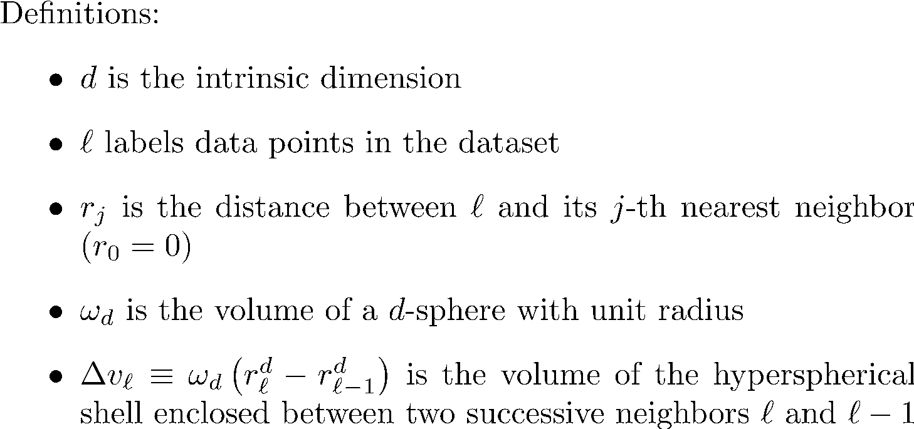

Slide 28

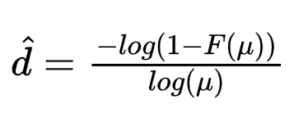
Hypothesis: The density is approximately constant on the lengthscale defined by the typical distance to the second neighbor
B.
Thesis: The cumulative distribution of the ratio of the second distance to the first one is assessable and it is a function of , and so it is possible to compute :

Slide 29
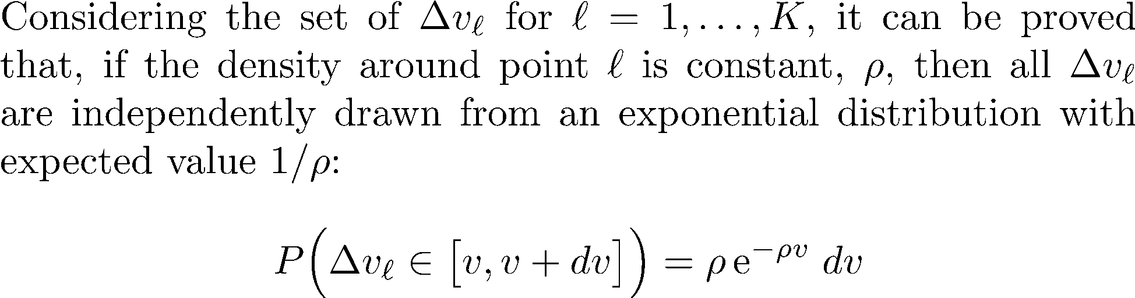

Slide 30
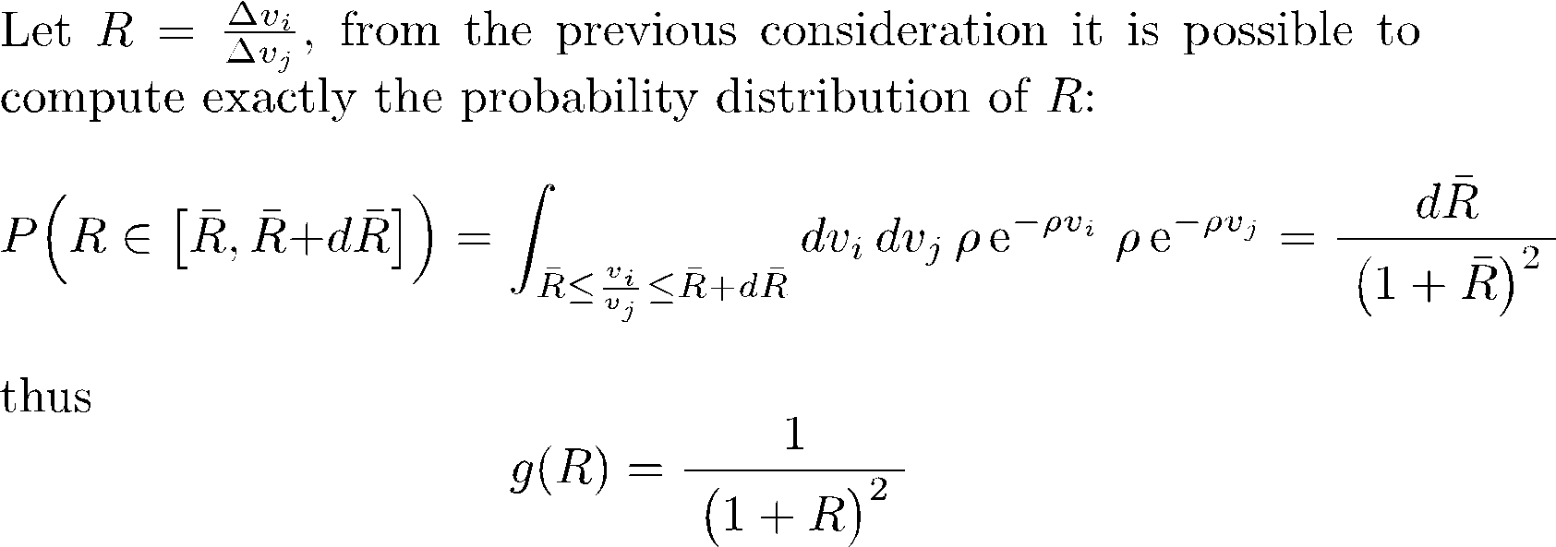

Slide 31
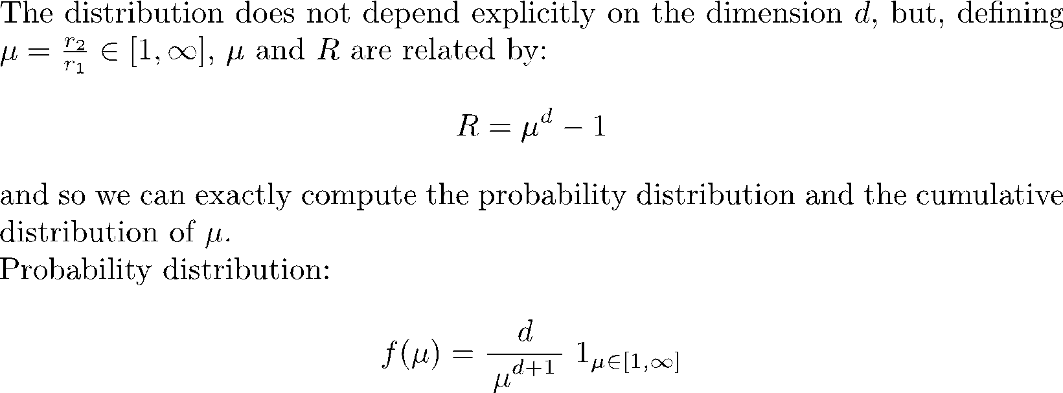

Slide 32
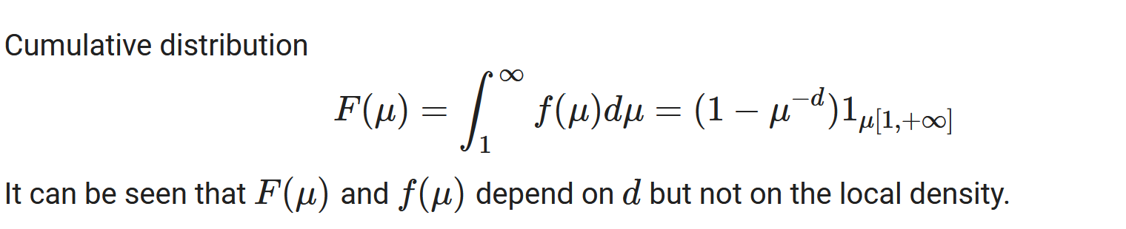
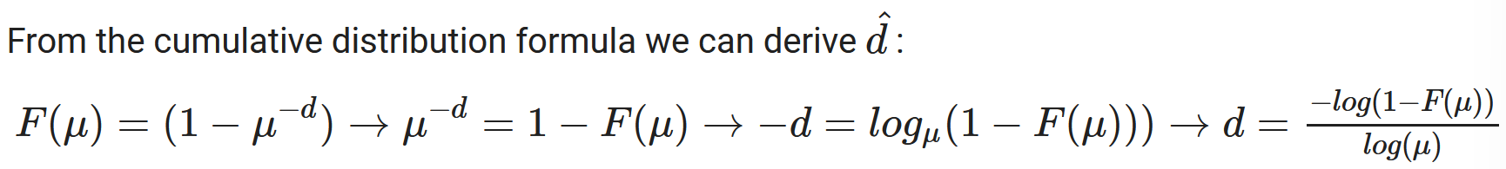

Slide 33
IMPLEMENTATION

Slide 34
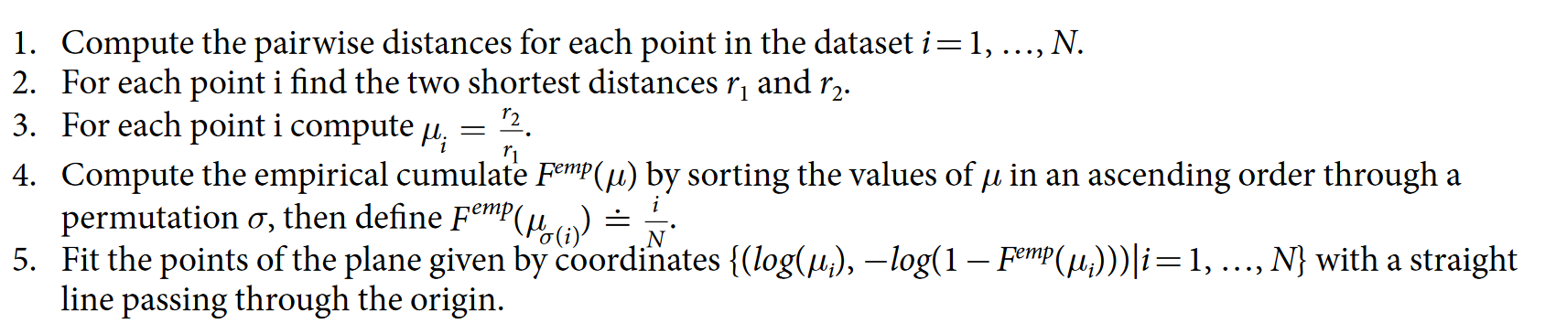
PSEUDO-CODE

Slide 35
Implementation procedure
Compute the pairwise distances dataframe.
Iterate the pairwise distances dataframe to find r1 and r2 for each point and return a list of mu values.
Creation of a function that given a list of mu values and a specific mu return the empirical cumulative probability.
Fit the points on a plane using the coordinates and do a linear regression with intercept=0.
return the slope of the line computed by the linear regression.

Slide 36
RUNTIME ANALYSIS

Slide 37
PSEUDO-CODE
IMAGE REFERENCE: https://www.nature.com/articles/s41598-017-11873-y.pdf

Slide 38
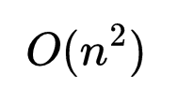

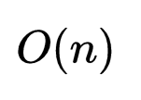
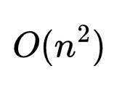
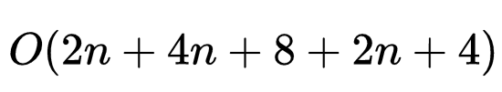
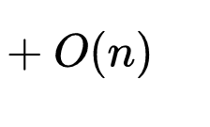

1)
2)
3)
4)
5)
RUNTIME FOR LINEAR REGRESSION HAVING X (n x m) and Y (n x 1)

Slide 39
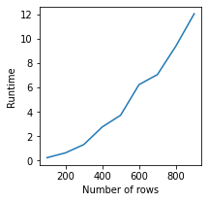
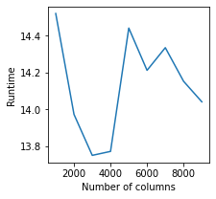
EMPIRICAL RUNTIME

Slide 40
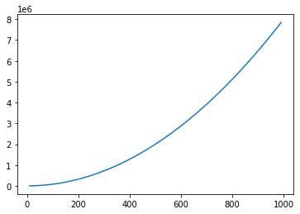
STORAGE ANALYSIS

Slide 41
Evaluation of the different algorithm with datasets having known ID

Slide 42
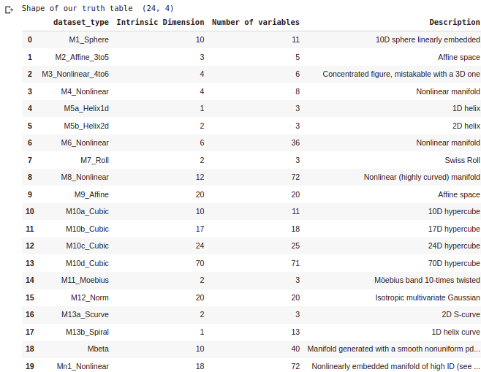
The dataset
Origin: scikit-dimension package

Slide 43
Evaluation Process
Use the default dataset
For each manifold apply the presented algorithms to estimate the ID:
Johnson Lidenstrauss projection method
Gaussian Random projection
MLE algorithm
PCA algorithm
2NN ID estimator
Determine the square distance error: (real_ID - calculate_ID)^2
For each manifold select the method having the lowest error

Slide 44
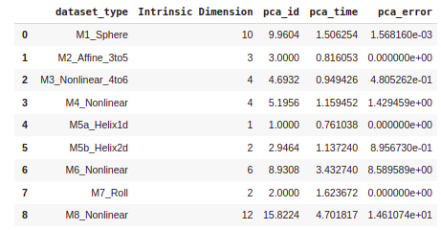
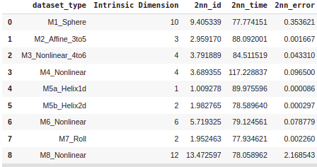
Evaluation of the ID

Slide 45
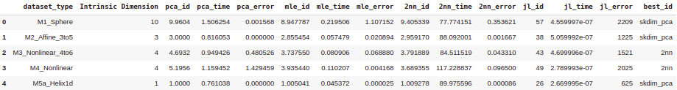
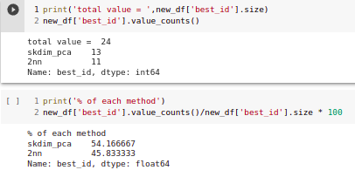
Error Analysis - Best methods

Slide 46
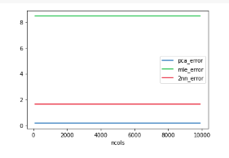
Evaluation:
Varying columns vs error
Process:
Fixed number of rows in the dataset (case Sphere)
Varying the column number from 100 to 10000
Comment: The number of columns or dataset features do not impact on the value of the error.

Slide 47
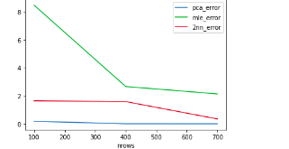
Evaluation:
Varying rows vs error
Process:
Fixed number of columns in the dataset (case Sphere)
Varying the number of rows from 100 to 1000
Comment: The number of rows has an impact on the error.

Slide 48
TEXT MINING EXAMPLE
“Represent a group of 1000 texts as an high dimensional dataset and then assess the intrinsic dimension”

Slide 49
GUIDELINE OF THE EXAMPLE:
Preprocess a set of texts about positive book reviews.
- TOKENTIZATION
- REGULARIZATION ( Deletion of punctuation)
- DELETION OF FREQUENT ENGLISH WORDS
- STEMMING
Determine the dimensions (python set of all possible preprocessed words)
Creation of a dataset where each line is a text and each column is a dimension (the value of the text components is the TF-IDF)
Application of ID estimator to the dataset

Slide 50
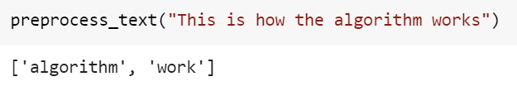
EXAMPLE OF PREPROCESSING AND TF-IDF
Preprocessing:
TF-IDF:

Slide 51
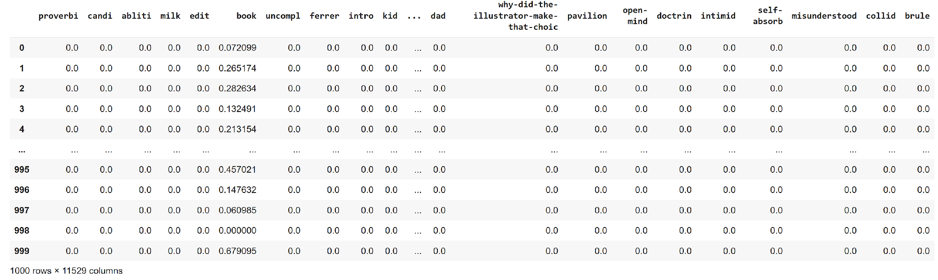
ORIGINAL DATASET

Slide 52
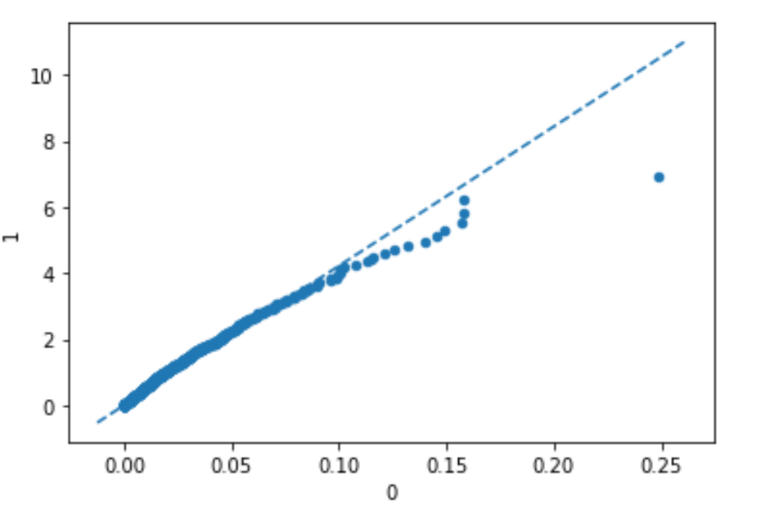
APPLICATION OF ID ESTIMATOR
THE ID RESULT IS ALMOST 42

Slide 53
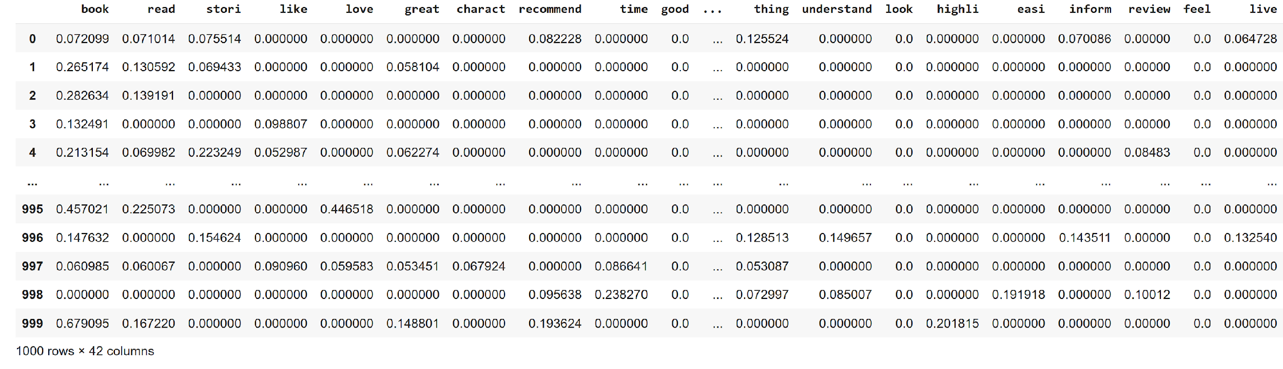
REDUCED DATASET

Slide 54
NEW DATASET DIMENSIONS
['book', 'read', 'stori', 'like', 'love', 'great', 'charact’,
'recommend', 'time', 'good', 'work', 'author', 'realli', 'life’,
'mani', 'make', 'novel', 'enjoy', 'reader', 'way', 'best', 'use’,
'peopl', 'written', 'want', 'write', 'world', 'page', 'know', 'think’,
'year', 'help', 'thing', 'understand', 'look', 'highli', 'easi’,
'inform', 'review', 'feel', 'live', 'histori']

Slide 55
Conclusion

Slide 56
IMPLEMENTATION SUMMARY
What is the intrinsic dimension (ID) of a dataset and why is important to assess it.
Existing approaches
Proposed approach TWO-NN
Implementation (N.B. part 4.5. Estimation of limit ID of a fixed distribution takes about 2h 30min to run due to high number of iterations and the large number of rows (10 000). It is not necessary to run it for the rest of the project, the result will be available on the next slide.)
Application to a text mining example
EVALUATION AND ASSESSMENT OF THE ID ESTIMATE

Slide 57
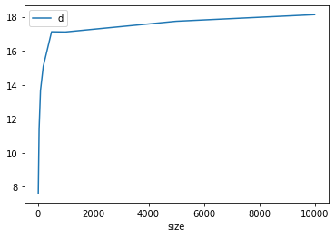


Result of execution of section 4.5. Estimation of limit ID of a fixed distribution
As the number of points tends to infinity the estimation of the cumulative distribution of gets more and more accurate
( )
as well as the estimation of the intrinsic dimension. As a result the estimation of ID tends to the real value of ID.

